Slide 1
Skills and Experience
Having around 3.5 years of experience on Python Automation testing.
Ability to work independently as well as in a team environment and success with meeting deadlines under time constraints.
Good in automation using Selenium Web Driver, Python,
Good in build tool and maintaining the project using Git.
Expertise in understanding and analyzing the Test Requirements, tracking changes and maintenance of regression test suits.
Good experience in interacting with Business Analysts, Software Developers, and Technical Support and help them in base line the requirement specifications.

Slide 2
Technical skills
Programming language :Python
Testing tools: robot frame work
Integrated Development Environments: PyCharm.
Version Control Tools: GIT HUB.
Tools :JIRA
MAIL ID : erraguntla.parvathi@hcl.com
SAP ID : 51997397

Slide 3
WEARABLE HEALTH MONITORING SYSTEMS

Slide 4
INTRODUCTION
HUB UI AUTOMATION:
By using Hub UI doctor can monitor the patient condition inside hospital or outside hospital for that they developed this Hub UI.
Automation Hub is a collaborative process identification, automation pipeline management, and process repository tool that accelerates the adoption of RPA across an organization, by building an RPA Community of Interest that puts the employees in the driver seats of automation initiatives.

Slide 5
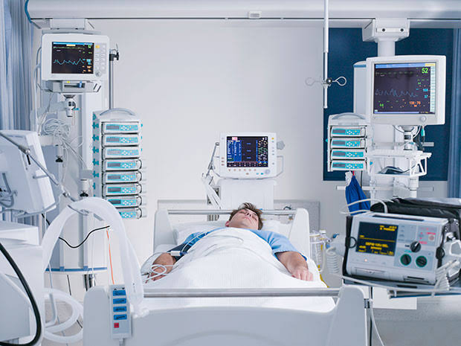
ICU
Hospital Environment

Slide 6
In this HUB UI we are automat in the hospital environment ICU which data it is presented that data it is showing in the HUB UI. So we are automating the application. In this application.
Here few electrodes are Connected in to the chest body and SPO2 the data comes from the patient through it will reach to via PMN into HUB UI.
Here it is showing,
SPO2 ---→ 98
Ps ---→ 95
Resp ----→ 25

Slide 7
This data will be presented in HUB UI we need to do automation for every alarms for examples,
Physiological Alarms:-
SPO2 Low alarms
SPO2 High alarms
Pulse Low alarms
Resp Low alarms
Resp High alarms
SPO2 Critically Low alarms
SPO2 Critically High alarms

Slide 8
Technical Alarms:-
->Battery low alarm
->Battery High alarm
->Electrode removed from patient body technical alarm

Slide 9
ROLE & RESPONSIBLITIES:
Understanding and Analyzing the Stories the comes in each sprint which lasts for 10working days.
Developing the behave steps and scripting as per the stories.
Marinating the code in Git repository and follows the coding standards and run Check style to ensure the same.
Monitor the regression results on regular basis and raise the tickets and fix the failures .
Interacting with the clients on daily stand ups and status report toon shore.

Slide 10
THANK YOU

